Slide 1
Programming Fundamental
Week 07
Sobia Iftikhar
Sobia.Iftikhar@nu.edu.pk

Slide 2
Class 16

Slide 3
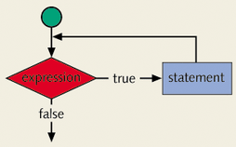
Concept of Looping (Repetition) Structure
One of the basic structured programming concepts
The real power of computers is in their ability to repeat an operation or a series of operations many times
When action is repeated many times, the flow is called a loop

Slide 4
What is Loop in C?
Looping Statements in C execute the sequence of statements many times until the stated condition becomes false. A loop in C consists of two parts, a body of a loop and a control statement.
The control statement is a combination of some conditions that direct the body of the loop to execute until the specified condition becomes false. The purpose of the C loop is to repeat the same code a number of times.

Slide 5
Why Is Repetition Needed?
Suppose we want to add five numbers (say to find their average).
From what you have learned so far, you could proceed as follows.
scanf(%d %d %d %d %d, &num1,&num2,&num3,&num4,&num5);
sum = num1+num2+num3+num4+num5;
average = sum/5;
Suppose we wanted to add and average 100, or 1000, or more numbers.
We would have to declare that many variables, and list them again in scanf statement, and perhaps, again in the output statement.

Slide 6
Repetition
There is two means of repetition
Counter-controlled repetition
Sentinel-controlled repetition
In counter-controlled repetition, a control variable is used to count the number of repetitions. The control variable is incremented (usually by 1) each time the group of instructions is performed. When the value of the control variable indicates that the correct number of repetitions has been performed, the loop terminates and execution continues with the statement after the repetition statement.

Slide 7
Repetition [Cont.]
2. Sentinel-controlled repetition
Sentinel-controlled repetition is sometimes called indefinite repetition because it’s not known in advance how many times the loop will be executed.
Sentinel values are used to control repetition when:
- The precise number of repetitions isn’t known in advance, and
- The loop includes statements that obtain data each time the loop is performed.

Slide 8
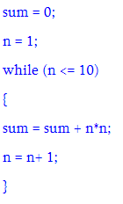
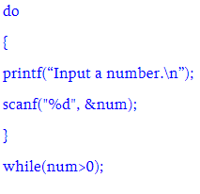
Repetition [Cont.]
Counter-controlled repetition Sentinel-controlled repetition

Slide 9
Class 17

Slide 10
Counter-controlled repetition
Counter-controlled repetition requires:
- The name of a control variable (or loop counter).
- The initial value of the control variable.
- The increment(or decrement) by which the control variable is modified each
time through the loop.
- The condition that tests for the final value of the control variable (i.e., whether looping should continue).

Slide 11
Loop Types
There are three repetition or looping structures in C that lets us repeat statements over and over until certain conditions are met.
while Looping Structure
for Looping Structure
do…while Looping Structure

Slide 12
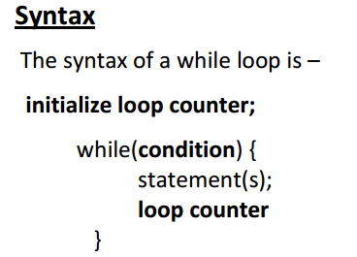
Loop Types [Cont.]

Slide 13
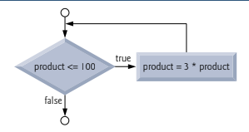
Loop Types [Cont.] Example:
As an example of a while statement, consider a program segment designed to find the
first power of 3 larger than 100.
product = 3;
while ( product <= 100 ) {
product = 3 * product;
}

Slide 14
Loop Types [Cont.]
Case-Study
A class of ten students took a quiz. The grades (integers in the range 0 to 100) for this quiz are available to you. Determine the class average on the quiz.

Slide 15
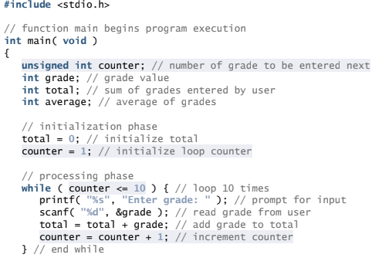
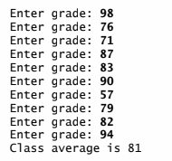
Counter-controlled Solution
If(grade =< 100)

Slide 16
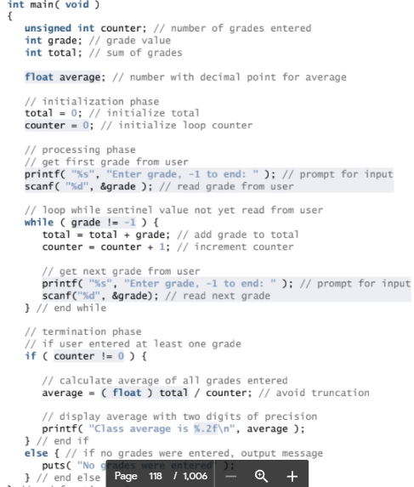
sentinel-controlled Solution

Slide 17
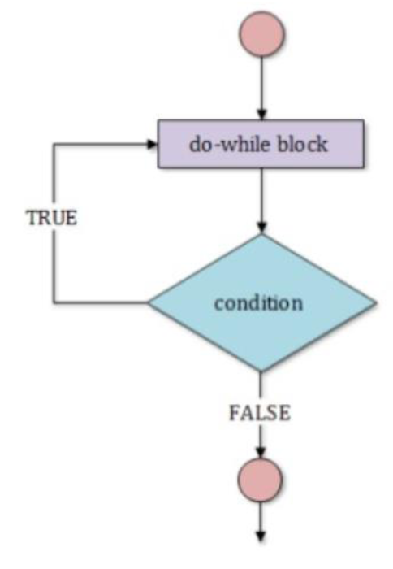
Loop Types [Cont.]
Do- while Loop:
The do while repetition statement is similar to the while statement.
The do…while statement tests the loop-continuation condition after the loop body is performed. Therefore, the loop body will be executed at least once. When a do…while terminates, execution continues with the statement after the while clause.
It’s not necessary to use braces in the do…while statement if there’s only one statement in the body. However, the braces are usually included to avoid confusion between the while and do…while statements.

Slide 18
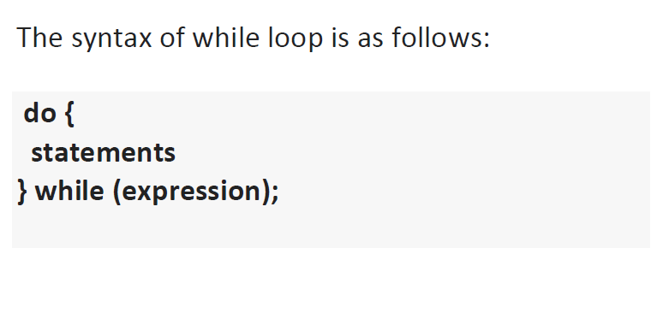
Loop Types [Cont.]

Slide 19
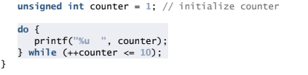
Loop Types [Cont.] Examples:

Slide 20
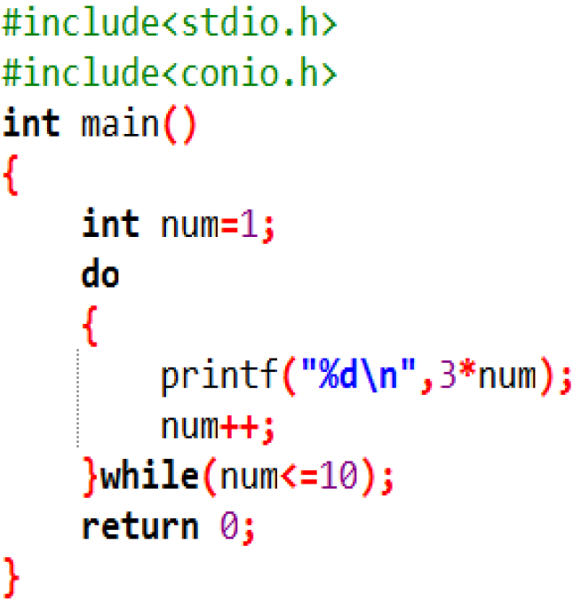
Loop Types [Cont.] Examples:

Slide 21
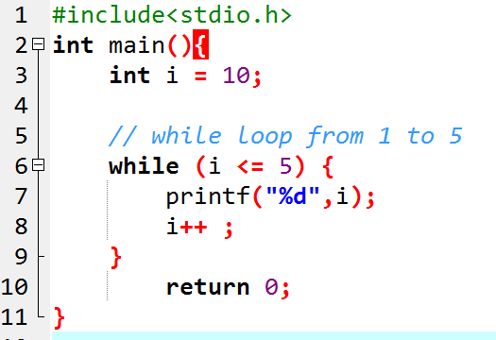
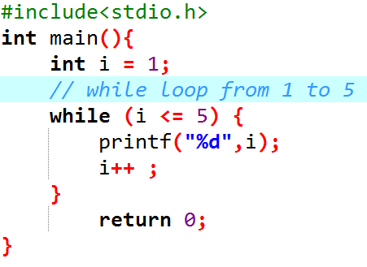
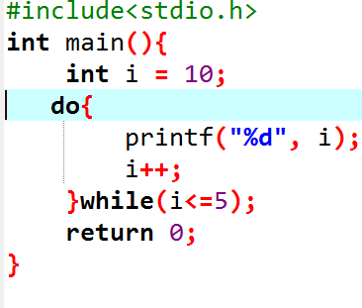
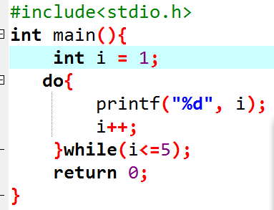




Example
Example 1: Display Numbers from 1 to 5

Slide 22
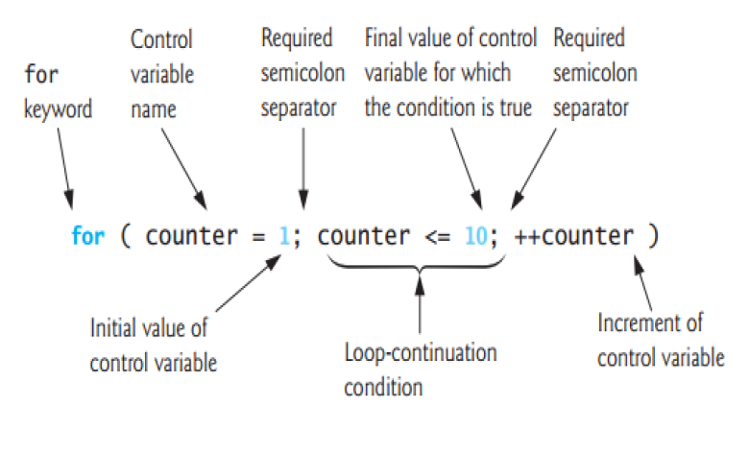
Loop Types [Cont.]
For Loop:
A for loop is a repetition control structure that allows you to efficiently write a loop that needs to execute a specific number of times.

Slide 23
Loop Types [Cont.]
Here is the flow of control in a 'for' loop −
The initialization step is executed first, and only once. This step allows you to declare and initialize any loop control variables.
Next, the condition is evaluated. If it is true, the body of the loop is executed. If it is false, the body of the loop does not execute and the flow of control jumps to the next statement just after the 'for' loop.
After the body of the 'for' loop executes, the flow of control jumps back up to the increment statement. This statement allows you to update any loop control variables.
The condition is now evaluated again. If it is true, the loop executes and the process repeats itself (body of loop, then increment step, and then again condition). After the condition becomes false, the 'for' loop terminates.

Slide 24
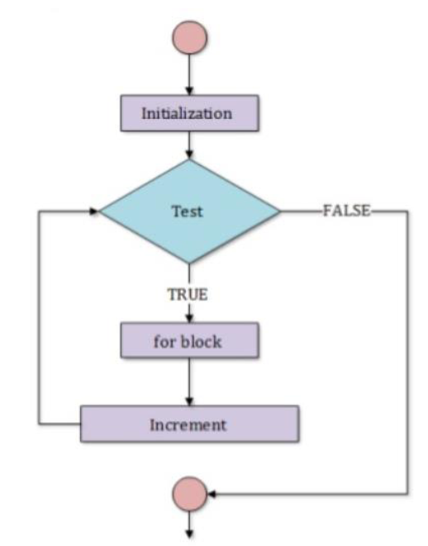
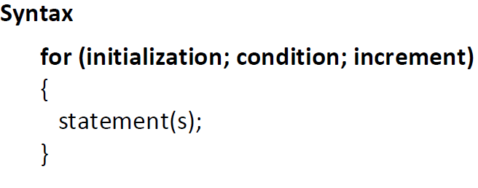
Loop Types [Cont.]
For Loop:
The for allows us to specify three things about a loop in a single line.

Slide 25
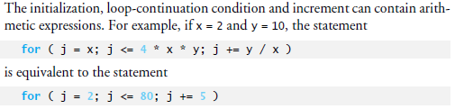
Loop Types [Cont.]

Slide 26
Loop Types [Cont.]
TASK:
Write a program to Calculate and Print Product of n odd integers. N will be inputted by user.

Slide 27
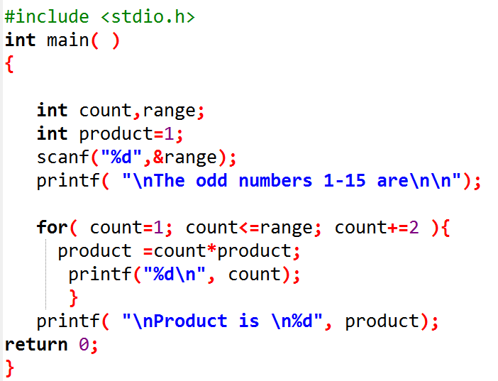
Loop Types [Cont.]

Slide 28
Exercise using while and do while
The body of the loop will process first before check the condition.
Example: Get the sum of 1, 2, 3, …100.

Slide 29
DO WHILE/WHILE Loop
Int n1=1;
Int total =0;
While(n1<=100){
total = total+n1;
n1= n1+1;
}Print total;
Int n1=1;
Int total =0;
Do{
total = total+n1;
n1= n1+1;
}While(n1<=100);
Print total;

Slide 30
Exercise
{
int count = 1, working_hours, over_time;
float over_time_pay;
while(count<=10)
{
printf("Enter the working hours of employee no %d: ", count);
scanf("%d", &working_hours);
if(working_hours>40)
{
over_time = working_hours - 40;
over_time_pay = over_time * 12.00;
printf("Employee No %d overtime pay is %.2f\n", count, over_time_pay);
}
else
printf("You have to work for more than 40 hours to get over time pay\n");
count++;
}
}
Q1 Write a program to calculate overtime pay of 10 employees. Overtime is paid at the rate of Rs. 12.00 per hour for every hour worked above 40 hours. Assume that employees do not work for fractional part of an hour

Slide 31
Class 18

Slide 32
Break statement
The break statement, when executed in a while, for, do…while or switch statement, causes an immediate exit from that statement. Program execution continues with the next statement.
The break statement is typically used for two purposes:
To exit early from a loop
To skip the remainder of the switch structure

Slide 33
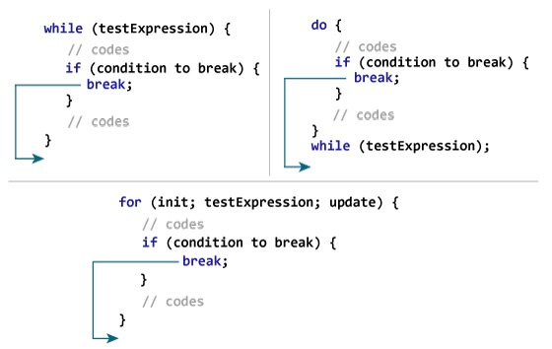
Break statement

Slide 34
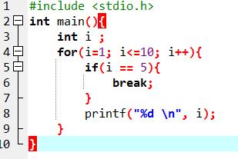

Break statement

Slide 35
Continue statement
The continue statement, when executed in a while, for or do…while statement, skips the remaining statements in the body of that control statement and performs the next iteration of the loop.
In while and do…while statements, the loop-continuation test is evaluated immediately after the continue statement is executed. In the for statement, the increment expression is executed, then the loop-continuation test is evaluated.

Slide 36
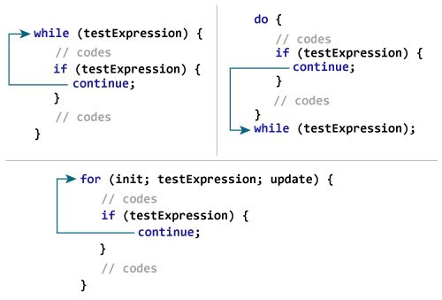
Continue statement

Slide 37
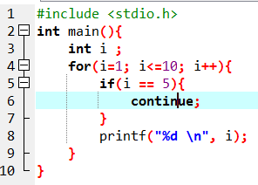
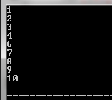
Continue statement

Slide 38
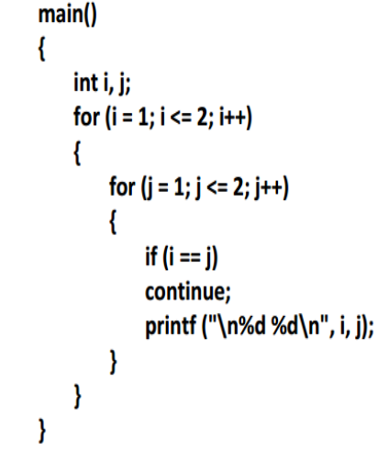
Continue statement

Slide 39
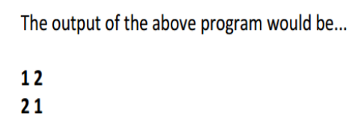
Continue statement

Slide 40
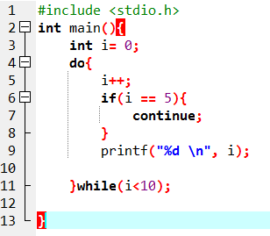
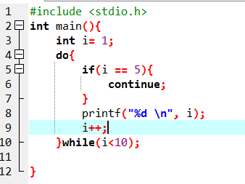



Slide 41
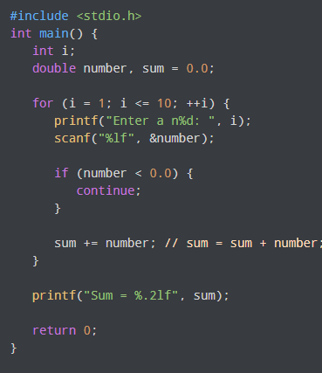
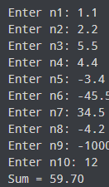
Example

Slide 42
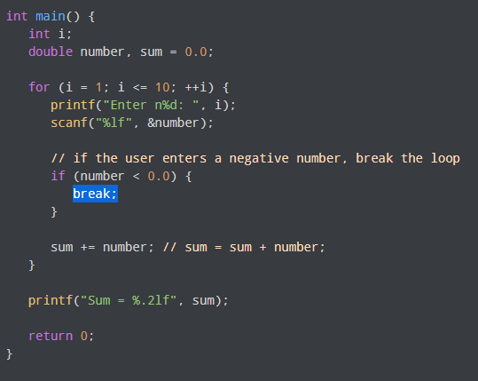
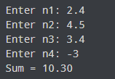
Example

Slide 43
Thankyou

